Slide 1
AVR|ADC (Analog to Digital)|

Slide 2
ADC | INTRODUCTION
An analog-to-digital converter (ADC, A/D, or A to D) is a device that converts a continuous physical quantity (usually voltage) to a digital number that represents the quantity's amplitude.
ADC often performs the conversions ("samples" the input) periodically.
The result is a sequence of digital values that have been converted from a continuous-time and continuous-amplitude analog signal to a discrete-time and discrete-amplitude digital signal.

Slide 3
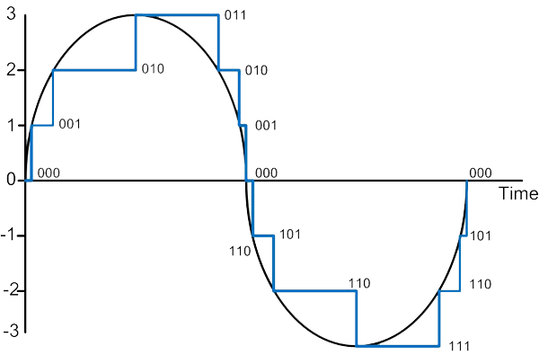
ADC | INTRODUCTION
Analog signal conversion to Digital is actually a stair case conversion rather a into absolute form.

Slide 4
ADC | INTRODUCTION
ADC uses a Reference Voltage to convert the analog input.
1023 = 5V
255= 5V
512= 2.5 V
127= 2.5 V
0 = 0 V
0= 0 V
10 bit Resolution
8 bit Resolution

Slide 5
ADC | Introduction
Resolution: The minimum value of analog quantity for which the ADC responds.
Reference Voltage= 5 Volt
In 10 bit ADC
Resolution-- 5/1024 = 4.89 mV or around 5mV
In 8 bit ADC
Resolution-- 5/256 = 19.53mV or around 20mV

Slide 6
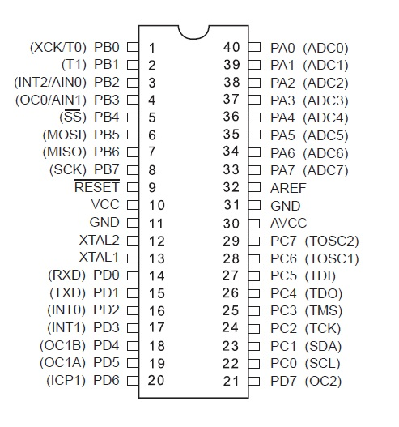
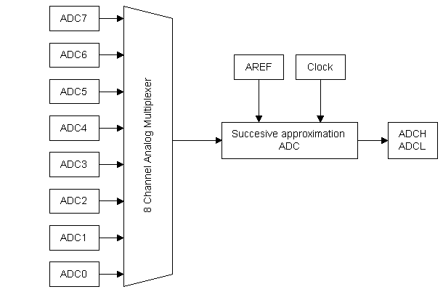
ADC | PINs in ATMega 16
IO PORT A / ADC PINS

Slide 7
ADC | Registers
There are three registers related to the operation of the ADC.
ADMUX
ADCSR
ADC Data register
ADCH
ADCL
Bit 7 | Bit 6 | Bit 5 | Bit 4 | Bit 3 | Bit 2 | Bit 1 | Bit 0
REFS1 | REFS0 | ADLAR | MUX4 | MUX3 | MUX2 | MUX1 | MUX0
Bit 7 | Bit 6 | Bit 5 | Bit 4 | Bit 3 | Bit 2 | Bit 1 | Bit 0
ADEN | ADSC | ADATE | ADIF | ADIE | ADPS2 | ADPS1 | ADPS0
Bit 15 | Bit 14 | Bit 13 | Bit 12 | Bit 11 | Bit 10 | Bit 9 | Bit 8
- | - | - | - | - | - | ADC9 | ADC8
ADC7 | ADC6 | ADC5 | ADC4 | ADC3 | ADC2 | ADC1 | ADC0
Bit 7 | Bit 6 | Bit 5 | Bit 4 | Bit 3 | Bit 2 | Bit 1 | Bit 0
ADCH
ADLAR = 0
ADCL
Bit 15 | Bit 14 | Bit 13 | Bit 12 | Bit 11 | Bit 10 | Bit 9 | Bit 8
ADC9 | ADC8 | ADC7 | ADC6 | ADC5 | ADC4 | ADC3 | ADC2
ADC1 | ADC0 | - | - | - | - | - | -
Bit 7 | Bit 6 | Bit 5 | Bit 4 | Bit 3 | Bit 2 | Bit 1 | Bit 0
ADCH
ADLAR = 1
ADCL

Slide 8
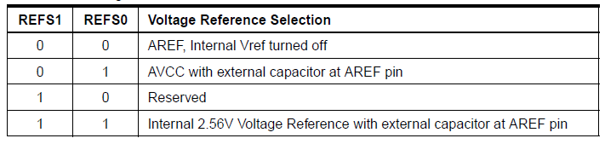
ADC | ADMUX
8 Bit ADMUX Register
Bit 7 | Bit 6 | Bit 5 | Bit 4 | Bit 3 | Bit 2 | Bit 1 | Bit 0
REFS1 | REFS0 | ADLAR | MUX4 | MUX3 | MUX2 | MUX1 | MUX0
ADC input (A0 to A7) pins are selected by using MUX4 to MUX0 bits.
Voltage Reference Selection for ADC

Slide 9
ADC | ADCSR
8 Bit ADCSR Register
Bit 7 | Bit 6 | Bit 5 | Bit 4 | Bit 3 | Bit 2 | Bit 1 | Bit 0
ADEN | ADSC | ADATE | ADIF | ADIE | ADPS2 | ADPS1 | ADPS0
ADEN - To Enable the ADC.
ADSC - To start each ADC conversion.
ADATE - ADC Auto Trigger Enable.
ADIF -This bit is set when an ADC conversion completes.
ADIE - When this bit is written to one and the I-bit in SREG is set, the ADC Conversion Complete Interrupt is activated.
ADPS2:0 - ADC Prescaler Select – To provide ADC Clock

Slide 10
ADC | ADCSR (Prescaler)
These bits determine the Prescaler, so the division factor between the AVR clock frequency and the ADC clock frequency.
ADPS2 | ADPS1 | ADPS0 | Division Factor
0 | 0 | 0 | 2
0 | 0 | 1 | 2
0 | 1 | 0 | 4
0 | 1 | 1 | 8
1 | 0 | 0 | 16
1 | 0 | 1 | 32
1 | 1 | 0 | 64
1 | 1 | 1 | 128

Slide 11
ADC | ADC Data Register
This register stores the value after ADC conversion. It is a 16 bit register divided in ADCL (8 bit) and ADCH (8 bit).
The ADLAR bit in ADMUX register defines how converted data is stored.
Bit 15 | Bit 14 | Bit 13 | Bit 12 | Bit 11 | Bit 10 | Bit 9 | Bit 8
- | - | - | - | - | - | ADC9 | ADC8
ADC7 | ADC6 | ADC5 | ADC4 | ADC3 | ADC2 | ADC1 | ADC0
Bit 7 | Bit 6 | Bit 5 | Bit 4 | Bit 3 | Bit 2 | Bit 1 | Bit 0
ADCH
ADLAR = 0
ADCL
Bit 15 | Bit 14 | Bit 13 | Bit 12 | Bit 11 | Bit 10 | Bit 9 | Bit 8
ADC9 | ADC8 | ADC7 | ADC6 | ADC5 | ADC4 | ADC3 | ADC2
ADC1 | ADC0 | - | - | - | - | - | -
Bit 7 | Bit 6 | Bit 5 | Bit 4 | Bit 3 | Bit 2 | Bit 1 | Bit 0
ADCH
ADLAR = 1
ADCL

